Slide 1
Network Anomaly Detection using Machine Learning
By
Venkata Satish Sirigina
Consultant at ADP

Slide 2
Agenda
Introduction
Data Preparation and Feature Selection
Machine Learning models for Anomaly Detection
Model Training and Validations
Implementation and deployment
Conclusion

Slide 3
Introduction
Anomaly is an observation that deviates significantly from the majority of the data points in a datapoint.
The traditional methods of network anomaly detection often rely on predefined rules or signatures based on known attack patterns.
These anomalies could signify a range of security threats, from compromised devices and malware infections to large-scale cyber-attacks like DDoS (Distributed Denial of Service).
To overcome ,build ML model which raise a suspicions as their characteristics deviate from what the machine learning build.

Slide 4
Data Preparation and Selection

Slide 5
Data Preparation
There are 3 different datatypes present in dataset provided.
1. Float --> 15 Features
2. Integer --> 24 Features
3. Object --> 4 Features
Dataset provided has total 43 Features and 125973 rows present.
Label data is provided for supervised learning.
There are no null values present in the dataset.
One feature “numoutboundcmds” has single unique value and it is dropped.

Slide 6
Categorize , created and added new features for Flag, Service and attack based on their category.
Calculated no of bits /sec for feature srcbytes and dstbytes and added to the dataframe.
Calculated rate count for all rate features.
Eg: df['dsthostsrvserrorrate_count']=df['dsthostsrvserrorrate']*df['dsthostsrvcount’]
4.After all features created , now the dataset has 62 features and 125973 rows.

Slide 7
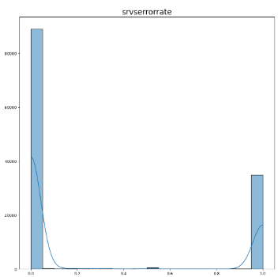
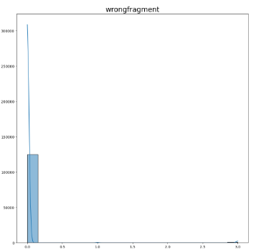
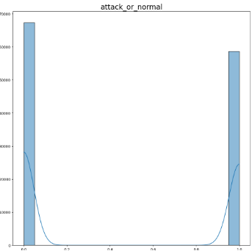
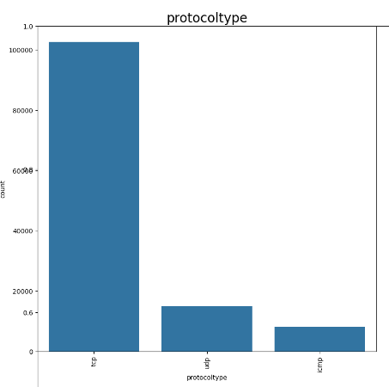
EDA Analysis
Most of the features in dataset are high at 0 and are right skewed.
All rate features are high at left and right side.
Attack feature are binary feature and have balanced data. We can do supervised learning on this label data
wrongfragment, dsthostcount, dsthostsrvcount, Count, Serrorrate, Rerrorrate, samesrvrate, diffsrvrate, srvserrorrate, srvrerrorrate, dsthostcount, dsthostsrvcount, dsthostserrorrate, dsthostrerrorrate, dsthost_samesrv_count, dsthost_diffsrv_count are giving the right insight regarding the attack. Along with that and also gives good insight regarding the attack.
TCP is most utilized protocol for establishing the connection.
Http and Privacy protocols are on top for data transfer.
Neptune type of attack is more when compared to other categories.
Flag SF is seen more on the visualization.

Slide 8
Model Training
We can perform Model training using Supervised (with Label) and unsupervised Learning(without label) algorithm because Label (attack feature) has been provided.
For Supervised we used Logistic and SVM
For unsupervised we used Isolation forest, Kmeans,tSNE,PCA and DBSCAN.

Slide 9
Supervised Learning
The accuracy score is good for SVC rather than Logisitic regression.
We can use SVC for ML Modeling.
For GV grid search SVC is very slow
Verified all the parameters and drafted in table.
From the graph we can see all are lead by SVC except AOC values.

Slide 10
Supervised Learning
Verified Duplicacy and verified collinearity using VIF.
Able to gather features less than VIF value 10 that has multicollinearity.
Total no of features removed by VIF is 6.
No of clusters formed for Kmeans is 3 and DBSCAN is 5 for best possible results.
While comparing Sillhouette and DPI score Kmeans is more favourable as very good neighboring clusters.

Slide 11
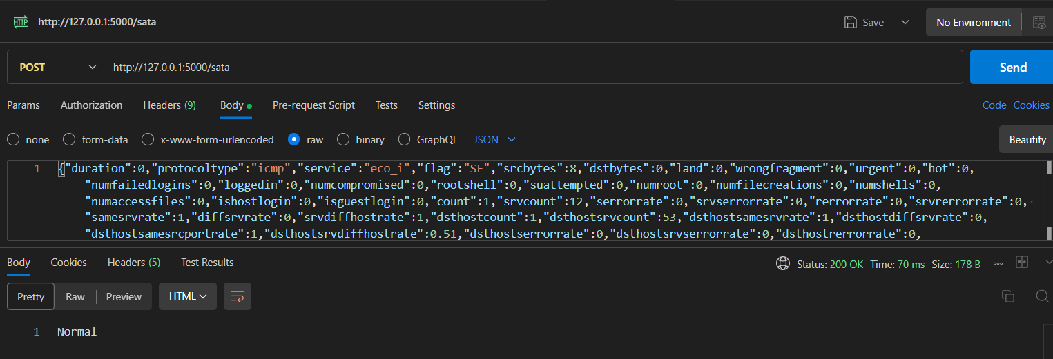
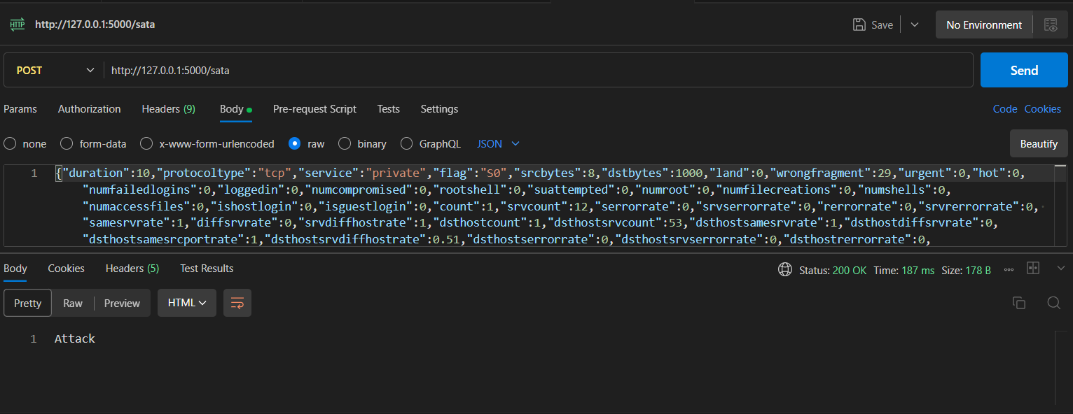
Validation of the ML Model

Slide 12
Conclusion
We have identified SVC best fitted model for this dataset, but it is time complexity increased more than 2 seconds during parameter tuning.
Error flag,urgent,service are more significant for detecting anomalies.
Srcbytes,diffsrvcount,dstbytes,flags,service have high feature importance.
For anomaly detection , SVC or Isolation Forest model is preferred and results provided as by using Isolation Forest.

Slide 13
Thank you

